Slide 1

Optimizing Where to Establish a New Hotel on the Most Tourist-Visited Philippine Provinces as Analyzed Through Foursquare API Location Data Using Unsupervised Machine Learning Algorithm
Sandy C. Lauguico
July 2020
Coursera Applied Data Science Capstone Project

Slide 2








Introduction
Having the Department of Tourism’s (DOT) slogan, “It’s more fun in the Philippines,” the country’s tourism is one of the growing sectors that significantly contribute in the economy. It attracted 8,211,535 foreign tourists in different provinces last 2018 due the following:
Beautiful islands
Inexpensive goods and services
Fluent English speakers
Hospitable people
Thrill-seeking adventures

Slide 3



Business Problems
To identify the solutions needed to address the problems
The current construction industry that is working together with the DOT is possibly relying on different inferences on where to best place a new hotel. This may result to potential investment losses and inefficient use of resources. A data-driven analysis would significantly provide a decision that can maximize profit while promoting tourism.
Where to establish new hotels?
To optimize resources
What are the most visited provinces?
To maximize profit
Which provinces lack hotel?
To improve tourism

Slide 4





Provinces data
Location data
Tourism data
Hotels data
The objective of this project is to be able to effectively locate the best provinces where to establish new hotels. This optimal approach may help in decreasing the risks of losses and increasing the possibilities of win-win arrangement for businesses, communities, and customers. The data used are as indicated.

Slide 5
The methodology followed in conducting the project. Mainly, the steps were divided into 5 and will be thoroughly discussed in the following sections. These steps are data exploratory, where data were preprocessed. Data were also analyzed to determine some pre notions regarding the data to be used and integrated to the data to be obtained from Foursquare. After that, clustering was made, and the cluster map was superimposed to a choropleth map.
Superimposing cluster map to choropleth map
Clustering using K-Means
Methodology
Data from Foursquare and visualization
Data analysis
Data acquisition and exploratory

Slide 6

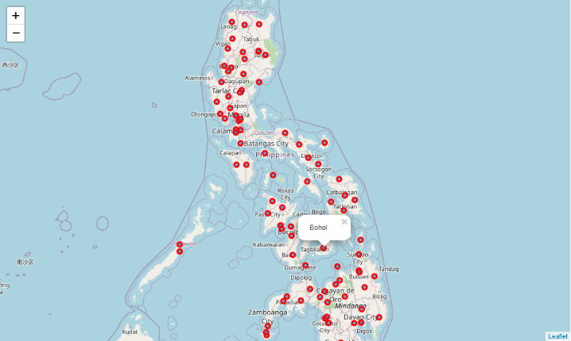
Data acquisition and exploratory
The list of provincial data from Wikipedia were scraped through the use Beautiful Soup. The class wikitable sortable was stored in a table to find the links that contained the string a. This string contains the values of the Provinces in the column of the table. By using a for loop, a list was created for each of the Philippine province. This was then turned into a dataframe. Geocoder was used to get the coordinates of each province and added to the dataframe which contains the provinces. Rows with NaN values were also dropped in the dataframe for further cleaning. Shown in the figure is the Philippine map with Province markings.

Slide 7
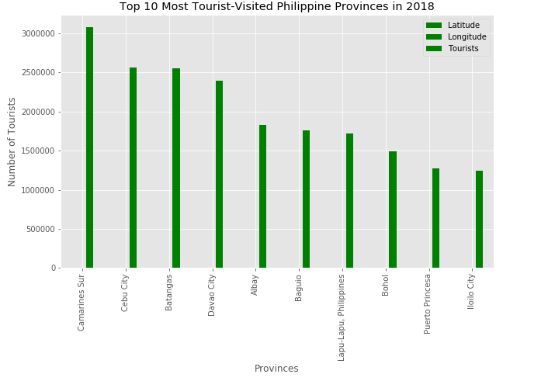
Data analysis
Another set of data was manually obtained and integrated to the dataframe. This new set of data consists the total number of tourists visiting a province. The figure below shows a bar graph for the top 10 most visited province in the Philippines in 2010 as this was extracted from the new data being merged to the original dataframe.

Slide 8
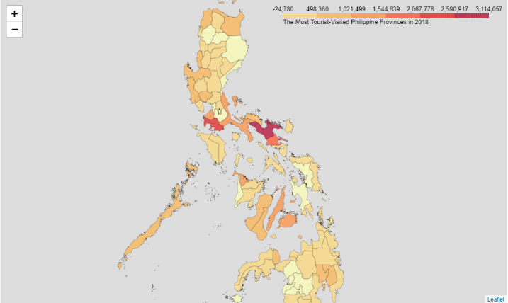
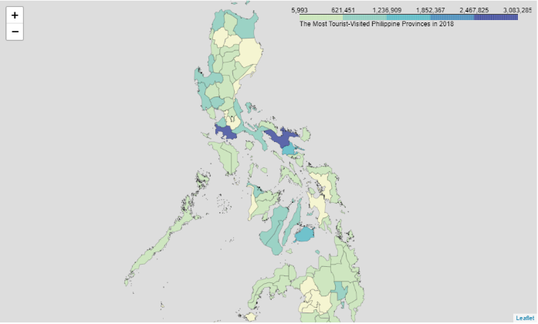
Data from Foursquare and visualization
A choropleth map was also generated to represent relatively the number of tourists visiting a province in terms of color intensity. Shown in YlOrRd fill color is the choropleth map. Since there are still negative values in the scale, a numpy array was used to scale the threshold as shown in the YlGnBu color fill.
Foursquare credentials were entered for accessing the data on venues existing in each of the province. A function was defined to to obtain the 100 nearby venues with a 500 m radius. A new dataframe that contains the venues and the venue categories was formed. One hot encoding was performed to represent data in terms of unique venue. The provinces by the mean frequency of the venue category was then stored in a variable to extract the dataframe which contains the provinces and hotel columns.

Slide 9
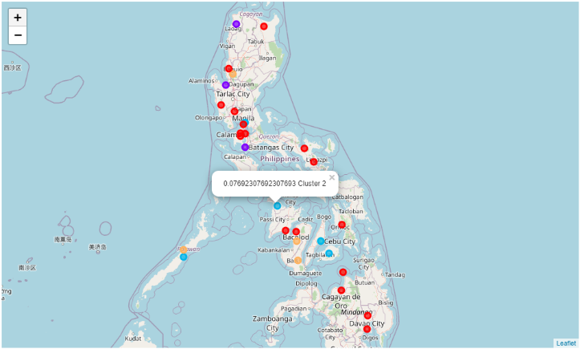
Clustering using K-Means
A total of five clusters were done through K-means Clustering to segment the hotel categories. The cluster labels produced were then merged into the original dataset which contains the provinces, their corresponding coordinates, and the total visiting tourists. The results were then visualized through a cluster map.

Slide 10
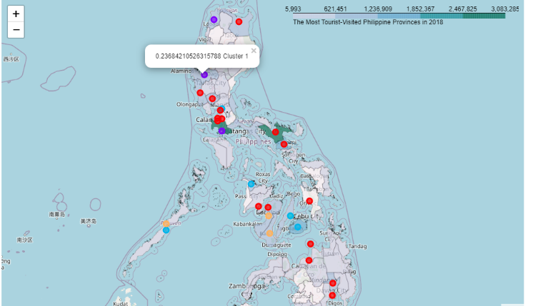
Superimposing cluster map to choropleth map
The resulting cluster map was then superimposed to the choropleth map which represents the total number of tourists visiting the province. Thus, it integrates the type of hotels that ware already existing in the provinces.

Slide 11

Results
Evaluating the five clusters provided, the following are the observation for each cluster:
Cluster 0
The cluster representing the province with the least
number of hotels within a 500 m radius.
Cluster 1
The cluster representing the province with the second
to the highest number of hotels within a 500 m radius.
Cluster 2
The cluster representing the province with the third
to the highest number of hotels within a 500 m radius.
Cluster 3
The cluster representing the province with the
highest number of hotels within a 500 m radius.
Cluster 4
The cluster representing the province with the second
to the least number of hotels within a 500 m radius.

Slide 12
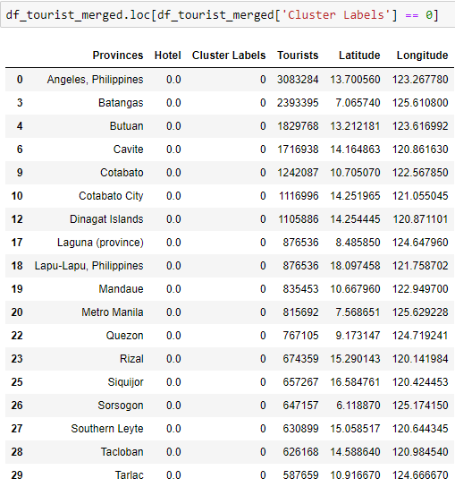
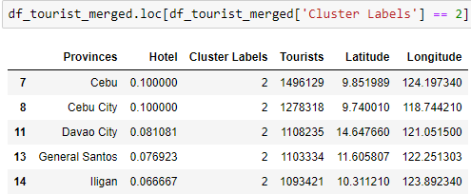
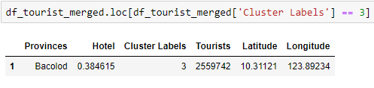
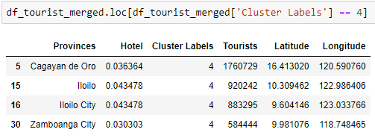
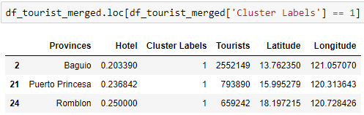
Shown in the following evaluation are the provinces with the hotels belonging to a cluster:

Slide 13
Discussion
Analyzing the table, none of the top 10 most tourist-visited province has a hotel cluster of 3 on which it is the cluster representing the highest number of hotels. Cluster 1, being the second to the highest number of hotels within every 500 meter-radius is only evident in Baguio and Puerto Princesa. This means that somehow these provinces can somehow accommodate the tourists visiting their areas. Cluster 2 is labeled on the top 2, 4, and 8 provinces which were Cebu City, Davao City, and Bohol. This cluster is the third highest frequency of existing hotel which means these provinces on the average can accommodate an acceptable number of tourists. However, Cebu City and Davao City which ranked 2nd and 4th on Cluster 2 needs at least Cluster 1, or better yet Cluster 3 to provide the best accommodation services to the tourists looking for hotels to stay in. The second to the least number of hotels represented by Cluster 4 is labeled on Iloilo City. This barely can accommodate 1.2 million tourists in the province. At least Cluster 2 or 1 is needed in this province. Lastly, the least number of hotels with Cluster 0 can be found on four of the top 10 most tourist-visited province, which are: Camarines Sur, Batangas, Albay, and Lapu-Lapu which ranked 1, 3, 5, and 7 respectively. With these rankings, these provinces deserve a clustering of at least Cluster 1 with the exception of Camarines Sur which needs Cluster 3, the highest number of hotels possible to exist in within every 500 meter-radius in the province.
Ranking | Provinces | Number of Tourists | Hotel Cluster
1 | Camarines Sur | 3,083,284 | Cluster 0
2 | Cebu City | 2,559,742 | Cluster 2
3 | Batangas | 2,552,149 | Cluster 0
4 | Davao City | 2,393,395 | Cluster 2
5 | Albay | 1,829,768 | Cluster 0
6 | Baguio | 1,760,729 | Cluster 1
7 | Lapu-Lapu | 1,716,938 | Cluster 0
8 | Bohol | 1,496,129 | Cluster 2
9 | Puerto Princesa | 1,278,318 | Cluster 1
10 | Iloilo City | 1,242,087 | Cluster 4

Slide 14

Conclusion
From all the evaluation and discussion of results, it can be recommended that 8 out of the top 10 provinces should be added with hotels. These 8 provinces are all except Baguio and Puerto Princesa. To further optimize the analysis, Camarines Sur should be the focus of the construction industry to establish so much more hotels as it has the highest number of tourists having their vacation back in 2018, yet grouped in the cluster with the least number of hotels available, in order to better accommodate all the tourists. The other seven provinces should also be added with more hotels in proportion to their tourism data and the hotel clustering labels they were labeled.

Slide 15
THANK YOU!

